Slide 1
FTC Driver Station
Setup and Operation
Mike Zook 20-Sep-2016

Slide 2
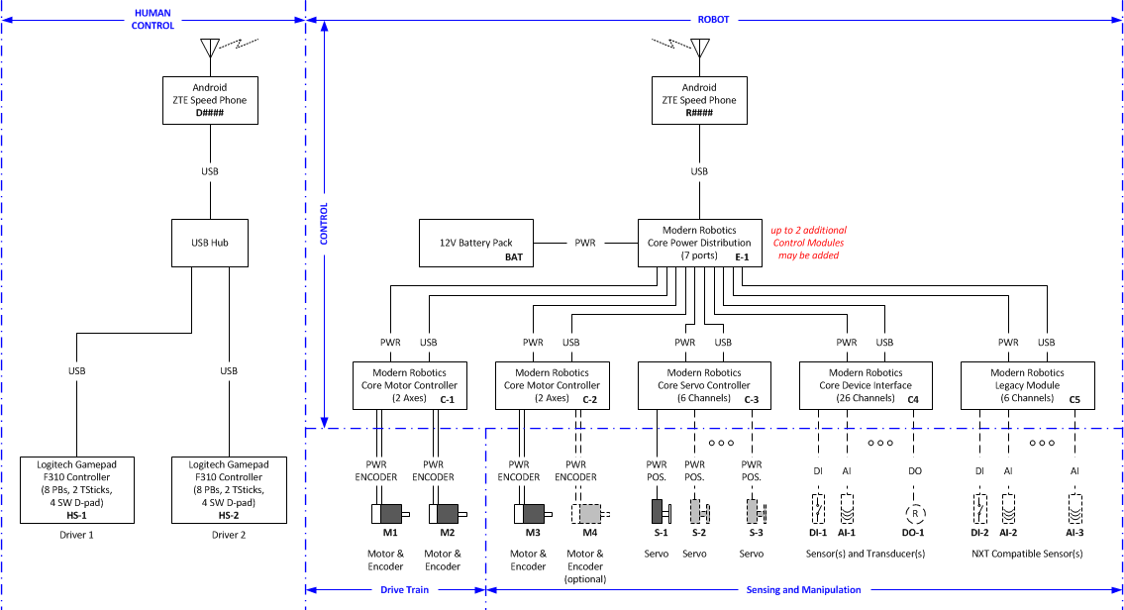
Hardware Overview
Driver Station

Slide 3
Start Up Order
Connect gamepads to USB hub
Plug hub into Driver Station Android
Open “FTC Driver Station” app
Driver 1: press <A> and <Start> on gamepad
Driver 2: press <B> and <Start> on gamepad
Ensure “FTC Robot Controller” app is running on Robot’s Android
Select desired Op Mode from the Driver Station
Enable Driver Station timed start/run if desired
Press the Driver Station play button
Note: Other startup sequences work as well, but if problems are encountered, follow these steps.

Slide 4
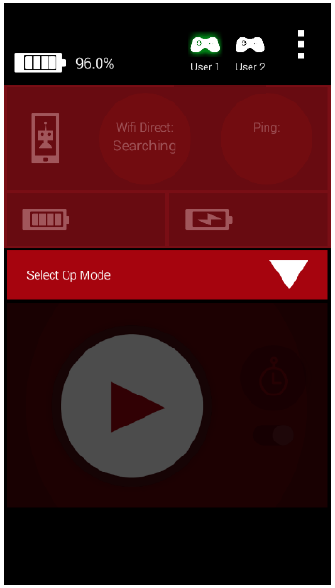
FTC Drive Station – Not Connected
Gamepad status (User 1 Active)
Robot not connected
Note: Driver Station appearance has changed slightly with the latest app version.

Slide 5
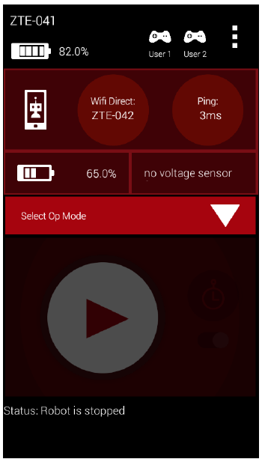
FTC Drive Station –Connected
Communication Status
Robot connected
Op Modes can be selected
(press for pulldown list)
Note: Driver Station appearance has changed slightly with the latest app version.

Slide 6
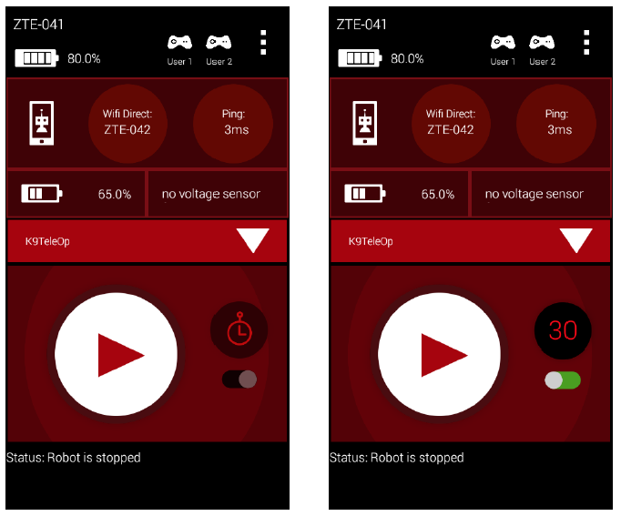
FTC Drive Station – Op Mode Selected
Selected
Op Mode
Play button enabled
Timed play enabled
Timed play disabled
Note: Driver Station appearance has changed slightly with the latest app version.

Slide 7
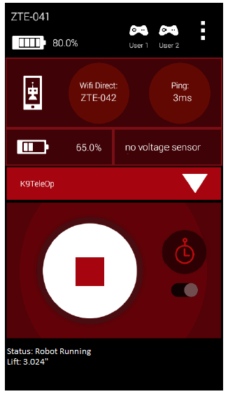
FTC Drive Station – Op Mode Running
Stop Button Enabled
Op Mode Data
(Set by programmers)
Note: Driver Station appearance has changed slightly with the latest app version.

Slide 8
Troubleshooting
Game Pad does not work
Ensure gamepad switch (on rear) is set to “x”
Ensure USB hub cables are fully connected
Unplug and turn off everything and redo setup
Robot will not connect
Ensure FTC Robot Controller app is running
Reconfigure point-to-point communication
Cannot locate the correct Op Mode
Ensure the correct FTC Robot Controller app is installed
Robot Controller app does not recognize attached modules
Check all USB cables; ensure they are attached and secured
Check power to all modules
Shutdown Power Distribution Module for 30+ seconds and restart.

Slide 9
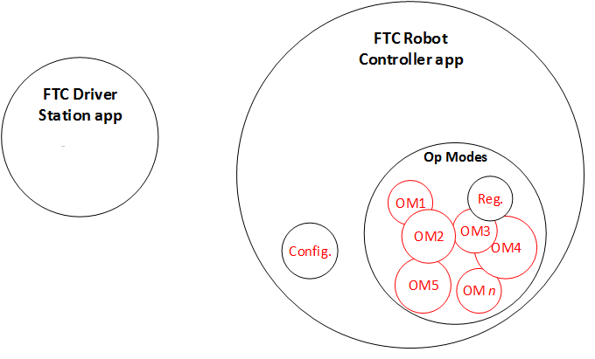
Programming Scope
The majority of the Robot Controller App is provided by FTC. We must …
Identify and Configure USB Controllers (e.g., Motor Controller)
Develop Tele-op Op Mode
Develop Autonomous Op Modes (as needed)
Register/enable Op Modes

