Slide 1
Introduction to Software Planning and Design
Mike Zook 24-Aug-2016

Slide 2
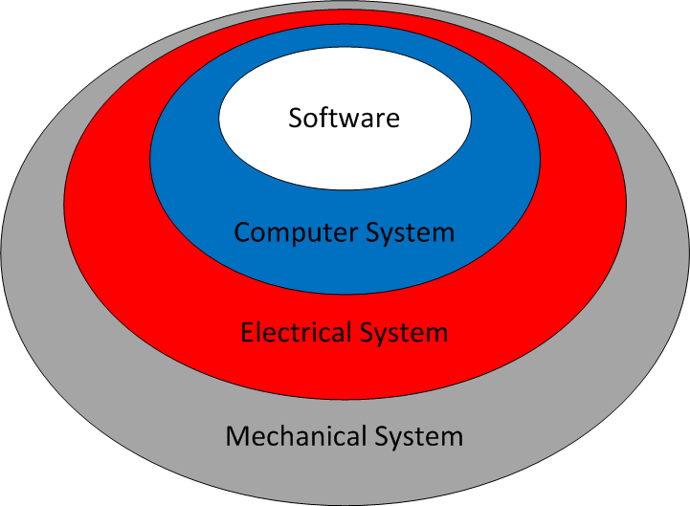
Robot Design

Slide 3
Code is not
Software Design

Slide 4
Software Life Cycle
Plan
Design
Program (Programming is not the first step!)
Test
Maintain
repeat

Slide 5
Software Planning
Scope
Purpose
Boundaries
Customers
Schedule
Requirements
User Interface Content
Objectives

Slide 6
Design (Document)
Process Sequences (flow charts, maps)
Error Handling
Algorithms (throttle interpreter)
Outputs (motors, servos, LEDs, solenoids)
Operator Interface (gamepad, displayed data)
Data organization (sensor inputs, constants, variables)
Software Organization (classes, methods)

Slide 7
Design (Prototype)
Write sample code to . . .
test design concepts and
to learn language attributes.

Slide 8
Software Design
Identify patterns and duplicate data.
Classes and super classes
Class variables and methods
Understand how elements of your design work together and develop a cohesive product

Slide 9
Now you can program
with confidence

Slide 10
Communicate
Mechanical design
Location of control elements
Motor and servo action
Electrical design
Selection and configuration of sensors
I/O Channel assignments
Driver Station configuration
Gamepad controls
Drive Station feedback

