Slide 1
Phone
Setup Overview
Mike Zook 20-Sep-2016

Slide 2
Training Objectives
There is no need to panic!
Nearly every setup step is described in the FTC Training Manual – Using the FTC SDK

Slide 3
Prepare Phones
Robot Controller and Driver Station Phones
Remove the SIM card (phone must be OFF)
Charge phones
Change phone settings
Airplane Mode enabled/ON
WiFi enabled/ON
Bluetooth disabled/OFF
Developer Options enabled/ON
USB debugging enabled
Connect to PC – Charge only enabled

Slide 4
Prepare Phones
Robot Controller Phone
Change phone name to “[Team Number]–[Optional Spare Device Designator]–RC” Examples: 8791-RC, 8791-A-RC
Load FTC Wi-Fi Direct Channel Changing App from Google Play

Slide 5
Prepare Phones
Driver Station Phone
Change phone name to
“[Team Number]–[Optional Spare Device Designator]–DS” Examples: 8791-DS, 8791-C-DS
Load Driver Station App from Google Play. Note: Drive Station app version number must match the Robot Controller app version number.
Configure Driver Station App
Select gamepad 1 and 2 types
Enable/disable network traffic logging (disabled is better)
Pair with Robot Controller

Slide 6
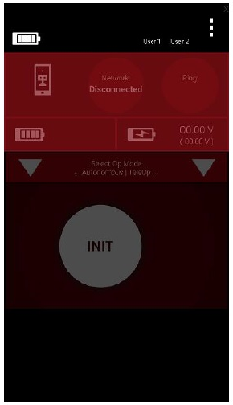
Pairing Phones
Power up the Robot Controller and Driver Station phones.
Open the Robot Controller and Driver Station apps.
Touch 3 dots to access Driver Station menu.
Select “Settings” to configure Driver Station.
Select “Connect with Robot Controller”.
Locate the Robot Controller phone in the pairing activity list and select it.
Exit the ‘Connect’ screen.
From the Robot Controller, “Accept” the invitation to connect to the Driver Station.

Slide 7
Reminder
There is no need to panic!
Nearly every setup step is described in the FTC Training Manual – Using the FTC SDK

