Slide 1
Sensors
Color Identification
Mike Zook 13-Sep-2016

Slide 2
Training Objectives
Color is described in 3 coordinates.
RGB and HSV color coordinates are provided by the FTC Robot App.
Many variables affect color measurement.
To promote accuracy, keep measurement conditions stable.

Slide 3
Color Coordinates
Color is typically defined in 3 coordinates
Common color coordinate types:
RGB – Red, Green, Blue
HSV – Hue Saturation Value
HSI – Hue, Saturation, Intensity
Each type has advantages depending upon the application.
The FTC Robot Controller app provides RGB by default and a method to convert RGB to HSV

Slide 4
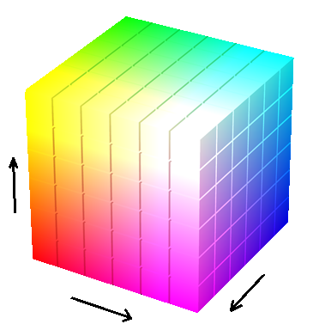
RGB Coordinates
Green
Red
Blue

Slide 5
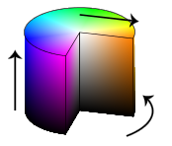
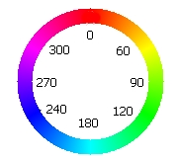
HSV Coordinates
Saturation
Value
Hue
Hue (0 to 360 degrees)
Saturation (% or count)
Value (% or count)

Slide 6
Mr. Zook’s Recommendation
Use HSV instead of RGB to identify line and beacon colors
Why? Because ….

Slide 7
Color Training
Establish relevant coordinate limits
Examples:
Blue
min blue hue < H < max blue high
S > min blue saturation
V > min blue value
Red
min red hue > H, or H < max red hue
S > min red saturation
V > min rd value
White
saturation < [colorful]
value > [dark]
Saturation
Value
Hue
White

Slide 8
Color Measurement
Color measurements are impacted by many variables including but not limited to:
proximity of sensor to object
light intensity and color
ambient
machine vision light source
lens filters (color, polarity)
noise (e.g., particulates, foreign objects)
Limit variables to improve measurement repeatability and accuracy!
Maintain sensor distance
Keep sensor distance short
Block foreign light sources

Slide 9
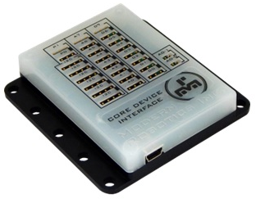
Sensor Setup
Sensor Outputs: RGB, Brightness, and many more (refer to color sensor specs for all outputs)
Lighting
Supplemental white light needed to differentiate field lines
Block all/most ambient light to identify beacon colors
Modern Robotics Device Interface Module
IC2 Channel – color measurements
DO Channel – White LED power/control
CAUTION – Each IC2 sensor must have a unique address

Slide 10
Greenwood Challenge
Create methods to identify line and beacon color.
Examples:
lineColor – returns red, blue, white, none
lineWhite – returns true or false
lineRed – returns true or false
beaconBlue – returns true or false
Create line following method.
Example:
Turn left if line detected.
Turn right if line lost.
Turn off if line lost for excessive time.

