Slide 1
Sensors
Quadrature Encoders
Mike Zook 30-Aug-2016

Slide 2
Training Objectives
Encoders are used to track position
Three modes of control:
Torque
Speed
Target
Math is your friend
Match motor outputs to encoder inputs

Slide 3
Encoders
Purpose: Track position and speed
Types and technologies:
Mechanical, optical, magnetic, etc.
Linear and rotary
Absolute and Incremental
Absolute encoders – true position
Incremental encoders – cycling outputs
We will use Quadrature Encoders (incremental encoder variety)

Slide 4
Quadrature Encoders
Two pulsing outputs (channels a and b)
Outputs are 90 degrees out of phase
Each output transition indicates …
incremental change in position
direction of movement
A third indexing output (channel z) may be included to flag motor “home” position.

Slide 5
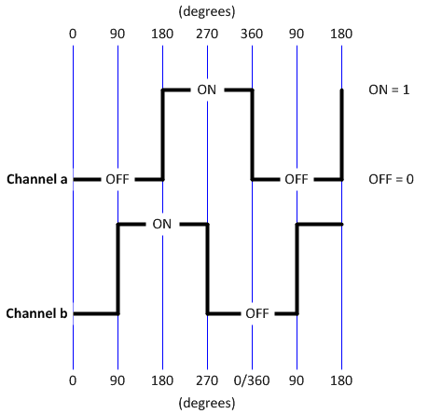
Quadrature Encoders
Same Signal Shape (square wave), but
90 degrees out of phase.

Slide 6
Quadrature Encoders
FORWARD MOTION
a | 0 | 0 | 1 | 1 | 0 | 0 | 1 | 1 | 0 | 0
b | 0 | 1 | 1 | 0 | 0 | 1 | 1 | 0 | 0 | 1
REVERSE MOTION
a | 0 | 1 | 1 | 0 | 0 | 1 | 1 | 0 | 0 | 1
b | 0 | 0 | 1 | 1 | 0 | 0 | 1 | 1 | 0 | 0
time
time

Slide 7
The Easy Part
Do not worry about decoding the signals; the motor ‘commands’ will do the work for you!
Define motion type
Torque,
Velocity, or
Position (go to target)
By default, all moves are absolute
Target Position units are “encoder counts”
Need to set Velocity too for position moves

Slide 8
FTC Robot Controller Motor Modes
RESET_ENCODER – sets current motor position to zero
RUN_WITHOUT_ENCODER
Torque motion type
“setPower” adjusts torque output
RUN_USING_ENCODER
Speed motion type; torque adjusted automatically
“setPower” adjusts motor speed
RUN_TO_POSITION
Position motion type
“setTargetPosition” used to define destination (absolute)
“setPower” adjusts motor speed; torque adjusted automatically

Slide 9
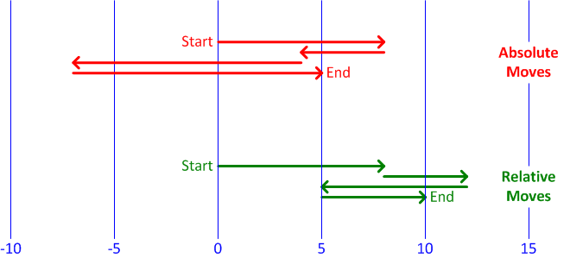
Absolute vs. Relative Moves
Go 8, Go 4, Go -7, Go 5

Slide 10
The Math Part
What is the relationship between encoder counts and distance travelled?
Given:
f(x) = Distance [encoder counts]
x = Distance [engineering units]
R_{ECR} = Encoder Counts per Revolution [counts/rev.]
G_{R} = Gear Ratio
W_{cir} = Wheel Circumference [engineering units] = 2r π
f(x) = G_{R} · [R_{ECR} / W_{cir}] · x

Slide 11
The Math Part - Example
How many counts are needed to travel 24 inches if wheel radius is 1.5 inches, gear ratio is 2:1, and a 1000 count/rev encoder installed?
Given:
f(x) = Distance [encoder counts]
x = Distance [engineering units] = 24 inches
R_{ECR} = Encoder Counts per Rev. [counts/rev.] = 1000
G_{R} = Gear Ratio = 2
W_{cir} = Wheel Circumference [engineering units] = 2r π
= 2 x 1.5 inches x π = 9.4 inches
f(x) = G_{R} · [R_{ECR} / W_{cir}] · x
= 2 · (1000/9.4) · 24
= 5106 counts

Slide 12
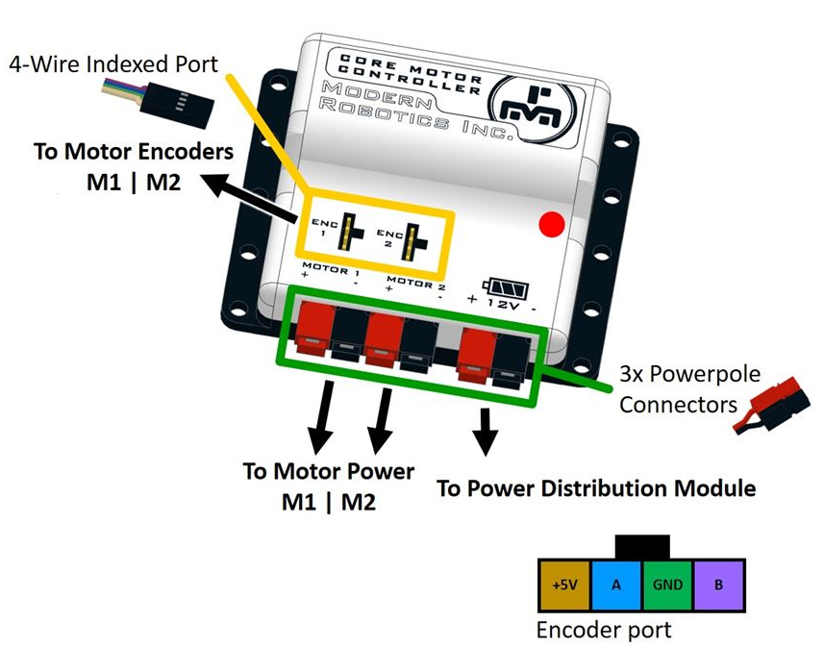
Core Motor Controller
Illustration by Modern Robotics

Slide 13
Training Objectives
Encoders are used to track position
Three modes of control:
Torque
Speed
Target
Math is your friend
Match motor outputs to encoder inputs

