Slide 1
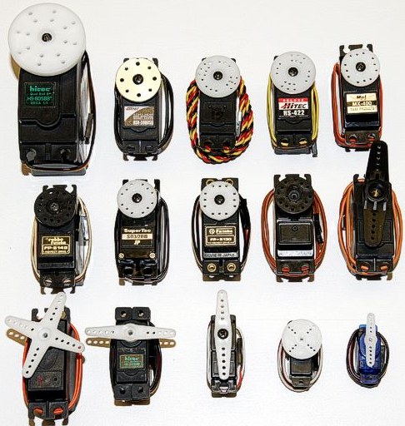
Servos

Slide 2
Learning Points
If properly applied, servos can provide precise positioning of machine components.
Do not expect a servo to operate over the full nominal range of motion.
For long life and repeatable operation:
Do not overtax a servo (or its servo controller);
Select and install the correct servo hardware.
Given the servo’s design, it cannot report actual position.

Slide 3
Servo Application
Used for precise positioning of machine components.
Typically limited to light duty (i.e., low torque) operation.
Typical range:
0-180 degrees or 0-90 degrees rotation;
360 degree continuous motion;
Some servos may be programmed for custom ranges.

Slide 4
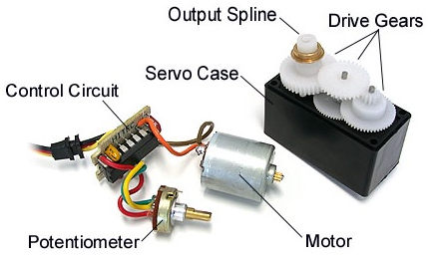
Internal Servo Components
Motor – Provides high speed and low torque output
Drive Gears – Decreases speed and increase torque
Output Spline – Provides a mechanical interface to machine
Potentiometer – Detects absolute position of Spline
CAUTION: Potentiometer output may vary over time which may impact overall range and neutral position.

Slide 5
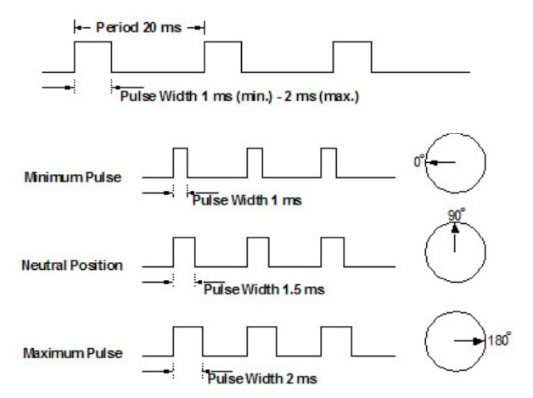
Servo Input – Pulse Width Modulation
CAUTION: Different servos may respond opposite of expectations (e.g., 1ms = 0 deg. or 180 deg.)

Slide 6
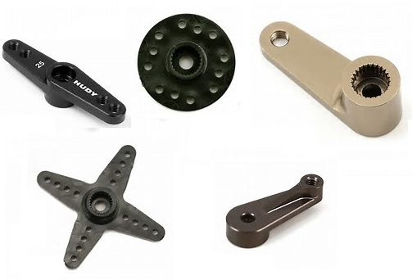
Servo Hardware – Hubs and Horns
Servo Horns
Servo-to-Machine attachment via linkage(s)
Servo Hubs
Direct Servo-to-Machine attachment
CAUTION: Servo splines come in many sizes and tooth configs. Select the correct horn or hub to mate to the spline.
CAUTION: Limit positional changes to avoid stripping splines, horns, hubs, and drive gears.

Slide 7
Modern Robotics Servo Controller
6 Servo Channels
3 Pins/Wires per channel (VDC, Com and AI)
Power Limited
6VDC, 1.5A per channel
6VDC, 5A total per module
CAUTION: An overtaxed servo may not achieve position.
CAUTION: One or more overtaxed servo(s) may impact the operation of other servos on the controller.
CAUTION: An overtaxed servo controller may impact the operation of all servos.
CAUTION: Servo position cannot be read by the controller.

Slide 8
Servo Commands/Methods
setDirection – define forward or reverse motion
setPosition – Command target position (0.0 to 1.0 = 0 to 100% of range)
getPosition – Returns the last commanded position, but not the actual position.

Slide 9
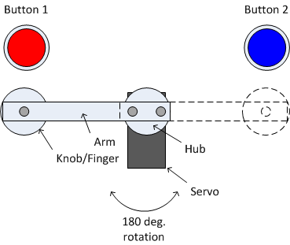
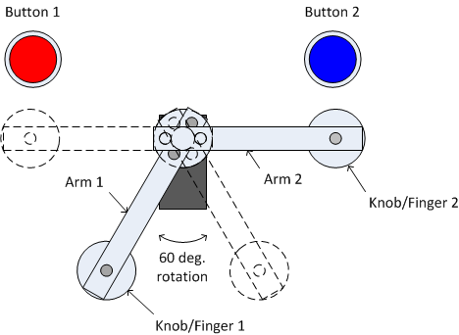
Example Servo Application
Strategic arm/finger/rocker design may provide balance and maneuverability with less movement

